Slide 1
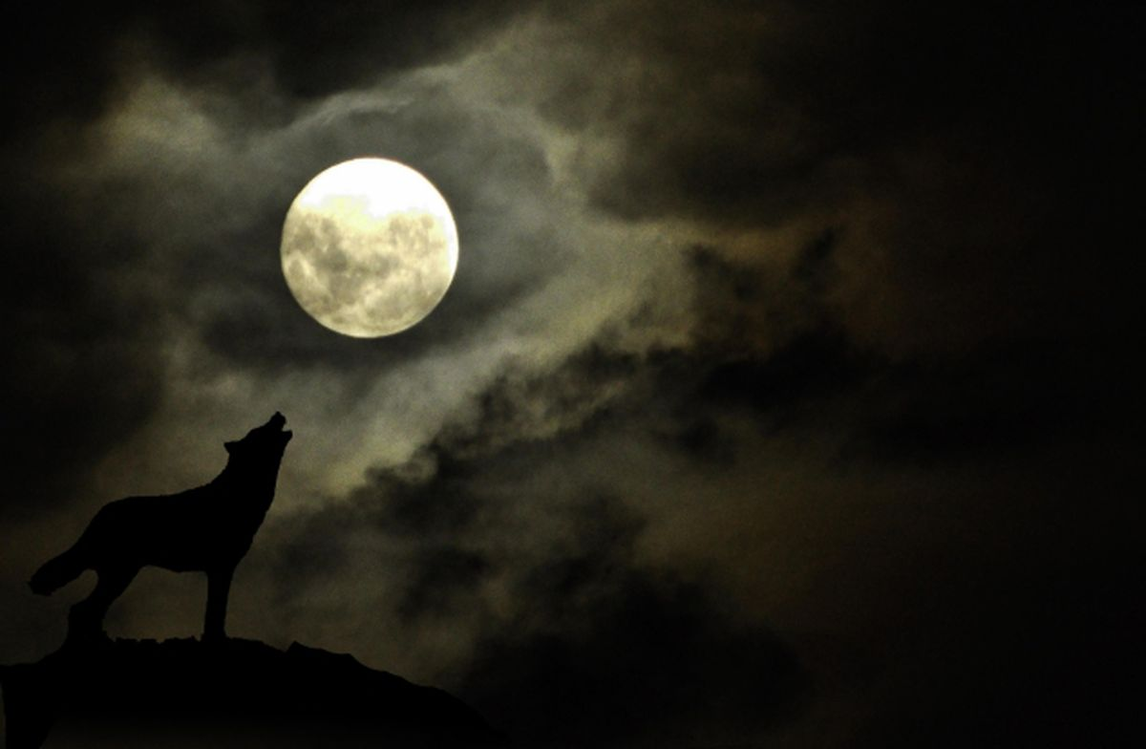
Lunar Cycle Craze?
Fox Aufenger, Chris Barlow,
Anne Ramer & Bridget Reardon

Slide 2
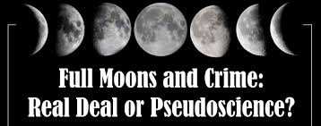
Motivation
What we were initially curious about…
Are stories of crime increasing on the full moon actually based in fact?
Is human behavior affected as much as we think by the lunar cycles?
Notes:
https://isteps.comp.nus.edu.sg/event/12th-steps/module/IS5126/project/13

Slide 3

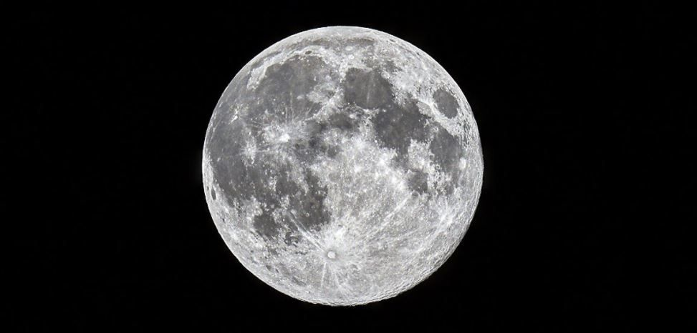
Hypothesis
Does a full moon actually cause an increase in crime?
Notes:
https://www.ny1.com/nyc/all-boroughs/news/2020/10/27/a-rare-full-moon--just-in-time-for-Halloween
https://www.lexipol.com/resources/blog/handcuffs-didnt-fit-and-neither-does-qualified-immunity/

Slide 4

Our Questions of the Data
Does the lunar cycle affect the crime rate in Baltimore, Boston, and Philadelphia?
Is crime actually higher during a full moon?
Are the trends consistent across all three cities?
Notes:
https://www.librarieshawaii.org/event/keiki-counting-challenge/

Slide 5
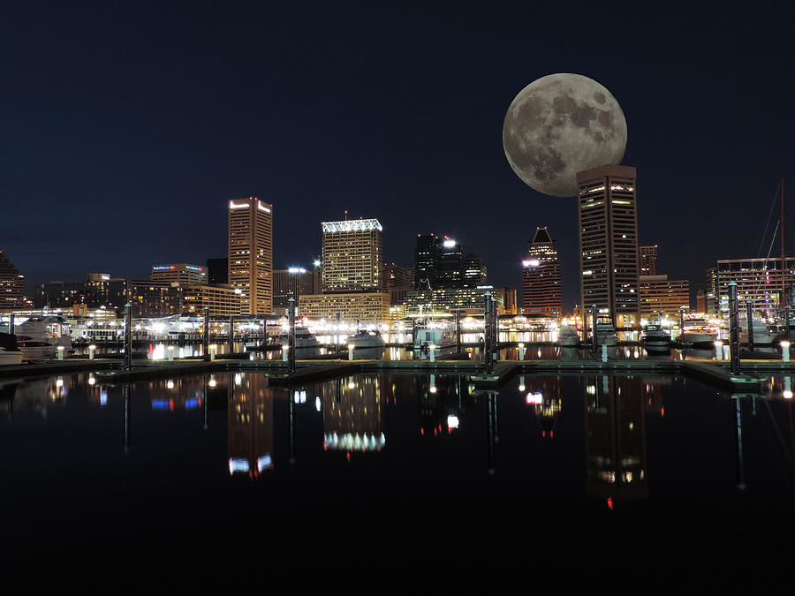
Data
We used Kaggle to find:
Full Moon Calendar
Crime in Baltimore
Crime in Boston
Philadelphia Crime Data
Baltimore at Night
Notes:
https://fineartamerica.com/featured/downtown-baltimore-maryland-night-skyline-moon-cityscape-photography.html

Slide 6
Data Exploration and Cleanup Process
Data imports from public data frames
Data cleanup for each city
Narrowed data frames to only crimes committed in 2016
Stored data chronologically
Created data frame to find the full moons in each month of 2016
Sorted full moon data by month
Issues with data
Crimes that were never reported
Other things that might affect crime rate (holidays, pay day)

Slide 7
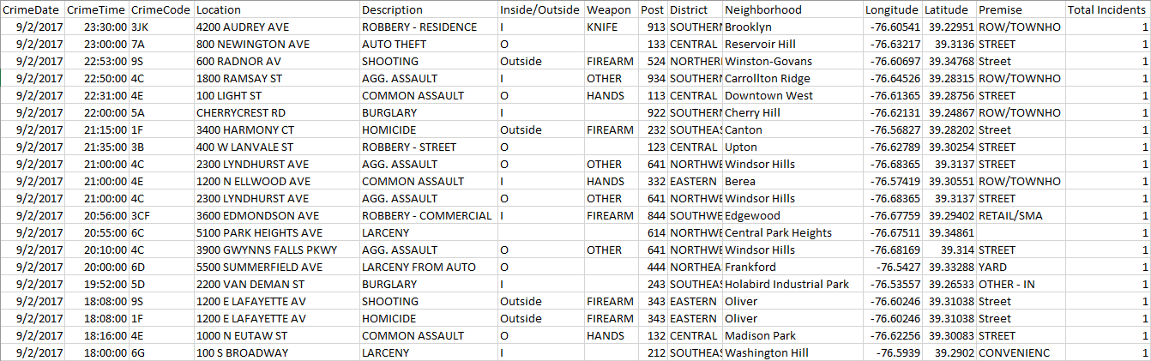
Example of Raw Data (Baltimore)

Slide 8

Data Analysis
Analyzed each month for all three cities in 2016
Statistical analysis of data found
Creation of data visualizations
Notes:
https://fcw.com/articles/2014/12/18/managing-a-cyber-crime-scene.aspx

Slide 9
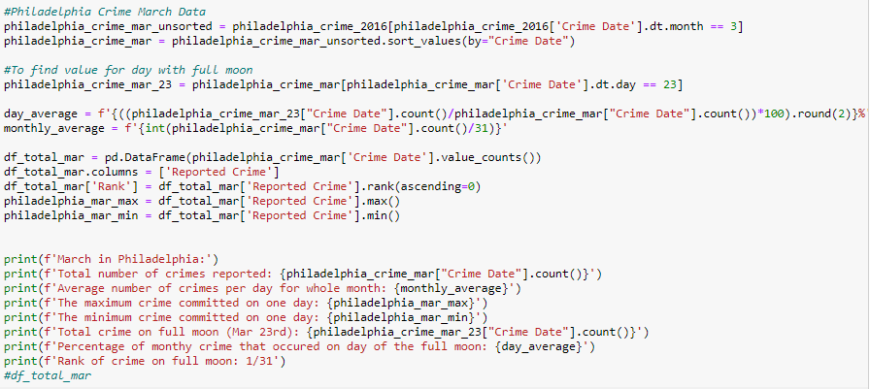
Some of our code…

Slide 10
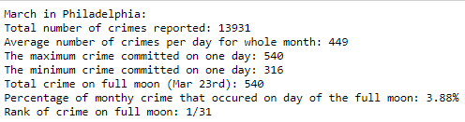
The result…

Slide 11
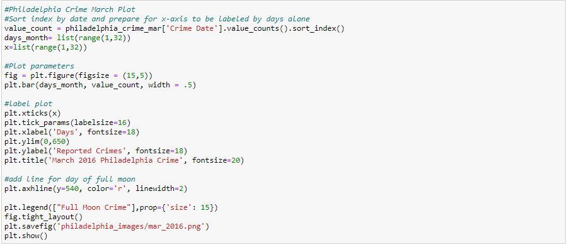
Matplotlib

Slide 12
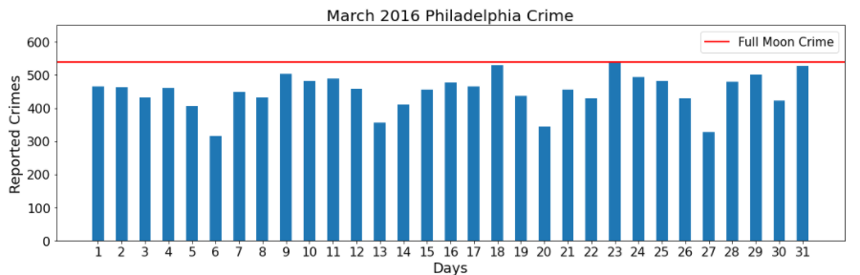
The plot result…
*This is the only month where our hypothesis was supported

Slide 13
Analysis of Full Moon Crime for Each City

Slide 14
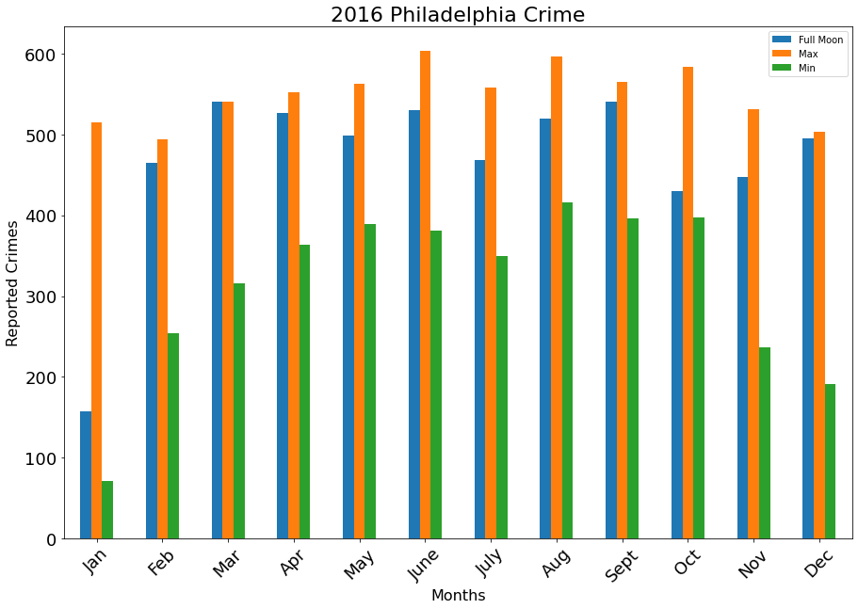
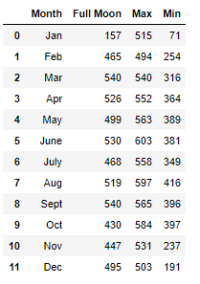

Slide 15
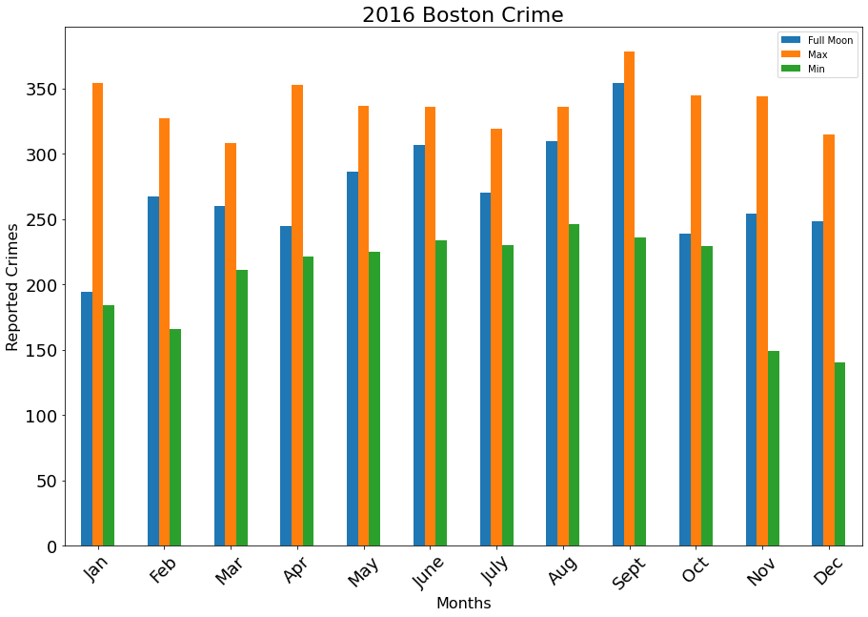
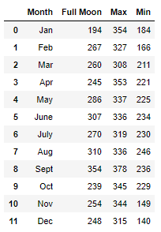

Slide 16
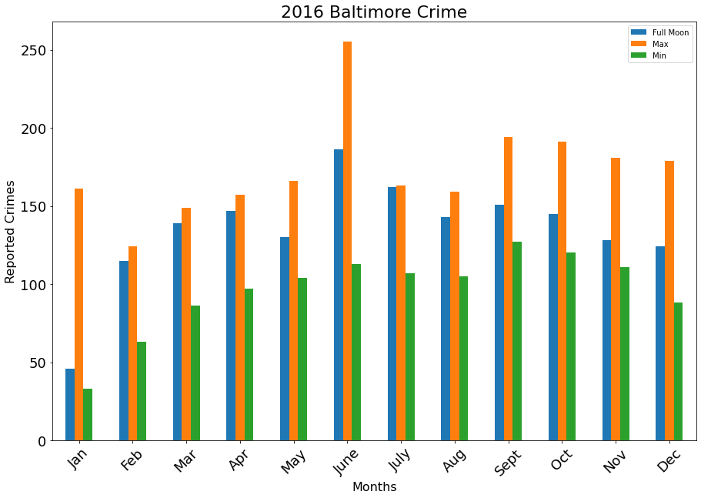
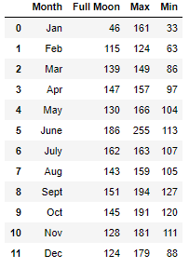

Slide 17
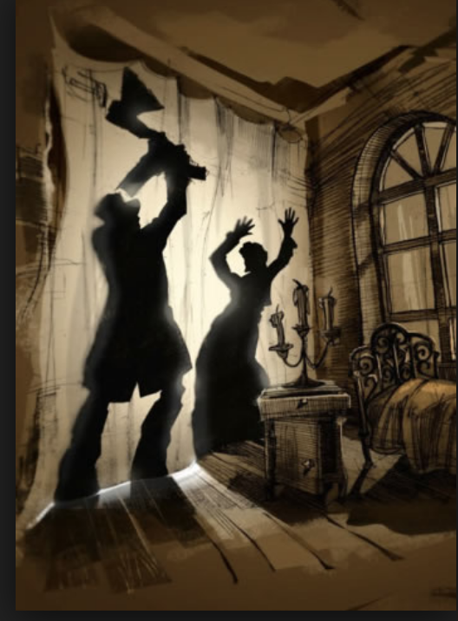
Findings
We reject our initial hypothesis
The crime rate where full moons occur are equal to the days without a lunar event.
Crime does not significantly increase on a full moon.
Crime increases during the summer months and decreases during the winter.
Warmer weather
Longer days
Notes:
https://medium.com/@spencerbaum/the-ethics-of-social-reform-in-crime-and-punishment-fab749e6c98a

Slide 18
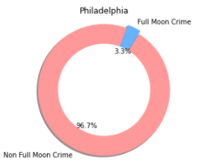
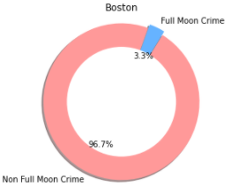
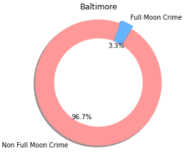
Total Crime vs. Full Moon Crime
For all three cities, the annual crime committed on nights with a full moon (total of 12 days) was 3.3%.
For all three cities, the average crime committed per 12 day period was 3.3%.

Slide 19
Post Mortem
Difficulties
Further Research
Git LFS
Type of graph to present information
Finding reliable data in the first place
The use of an API with the data we wanted (daily crime information)
Is a particular type of crime more common on nights with a full moon?
Does one phase of the moon impact crime rate more than others?
Does another astrological phenomenon (eclipse) affect crime rate?

Slide 20
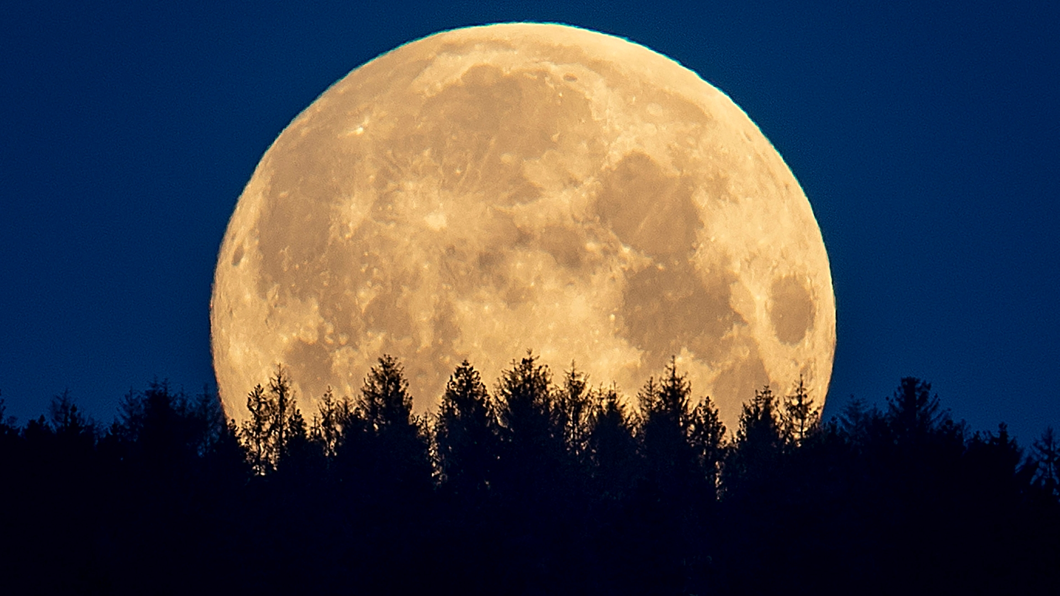
Questions?
Notes:
https://www.wdbj7.com/2020/07/31/augusts-full-moon-rises-sunday-night/

